Slide 1
Fundraising
September, 2021
Brought to you by the New Hampshire Young Democrats

Slide 2
Welcome, candidates!

Slide 3
Fundraising Workshop
Agenda
Introductions
Campaign Planning & Budgets: Why We fundraise
Circle of Benefits: Who to Fundraise From
Tactics: How to Reach Out
Tactics: What’s a Hard Ask?
Tactics: Call Time
Tracking Your Asks & Money Raised
Important Things to Remember
Follow Up
Campaign Finance

Slide 4
Campaign Planning & Budgeting
This is your first step, because you need to know how many voters you need to target, and how you will reach them and how often to get to your “win number,”
Build 3 budgets in your campaign planning. A bare bones budget, a regular what you need budget, and a reach “extras” budget.
These budgets will give you the numbers you need to raise that you will need to know to get started with your fundraising plan.

Slide 5
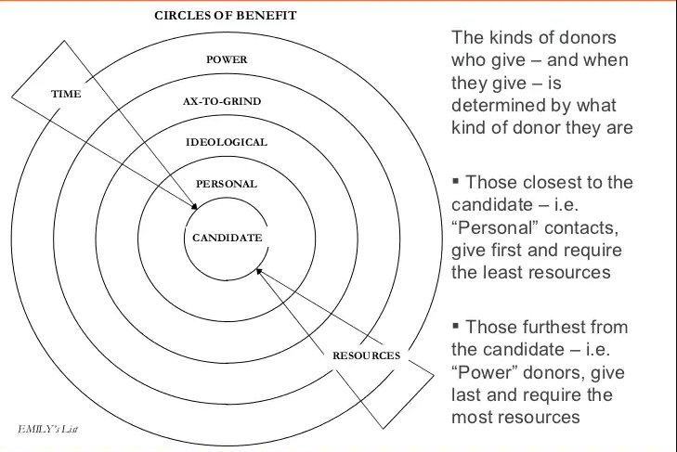
Circles of Benefit: Who to Ask
“Roladex” Yourself to See Who You Know
Use the Circles of Benefit to See Which Donors to Ask First
Estimate How Much Donors Can Give to Project What it Will Take to Fundraise Enough to Meet Your Budget

Slide 6
Tactics: How to Reach Out
A phone call (with a hard ask)> A Personal Text or Social Media Direct Message >Fundraising Letter or Email > A Social Media Fundraising Post

Slide 7
Tactics: What’s a Hard Ask?
Ask for a specific amount of money
Don’t hesitate or give folks an out
Let the prospective donor answer the direct question before moving on
If they say no to that specific amount, ask if they’d consider another lower amount, if no make a volunteer ask.
Example: “Can I count on you to contribute $50 today so I can get the mail pieces I need to spread my message to voters?”

Slide 8
Tactics: Call Time
Making sure you have dedicated time on your calendar
End your week by planning for your next week
Rolodex far ahead of time to make the most of your call time
Have a friend, volunteer, or staff member help you during call time
Make your asks intentional with specific dollar amounts and deadlines

Slide 9
Tracking Your Asks & Money Raised
Keep track of who you’ve asked and their contact information, how much you asked for, whether you’ve received it and when, and if and when you sent a “Thank You.”
Using a spreadsheet makes it easy to keep track of data and see what your progress is towards your fundraising goal. It also makes it very straightforward for campaign finance reporting, when you will need to report your contributions or expenditures to the Secretary of State or City Clerk.

Slide 10
Important Things to Remember
Asking for Money is Hard, and Takes Practice. Try, Try, and Try Again. Don’t take rejections personally, your next call will be better
You aren’t asking people for money for yourself. It’s about making your community better. People are often very excited about what you are doing and are very willing to donate, BUT ONLY IF YOU ASK THEM.
You are not your donor, don’t be afraid to ask for what people can afford to give. They’ll let you know if the amount isn’t ok.

Slide 11
Ask Early. Thank Well. Resolict
Rinse. Wash. Repeat.

Slide 12
Questions?
Thank you for joining!

Slide 13
This Training Provided Was Provided by the NHYD Elections Program
The New Hampshire Young Democrats have a proven track record supporting, advising, and fostering winning campaigns for young candidates. Established in 2008, the NHYD Elections Program works year-round to recruit, train, and elect the next generation of progressive leadership to local, state and federal offices.
NHYD is committed to providing the resources necessary to create the next generation of progressive political leaders in New Hampshire. The New Hampshire Young Democrats have supported over 180 young Democrats running in municipal and statewide campaigns to date.
Can you help support that work? Donate today via https://secure.actblue.com/donate/nhyoungdemocrats

Slide 14
Coming Soon:
Our intro to Canva Training
Create a free account → www.canva.com

